Slide 1

Policy as Code for Cloud Security and Compliance
Presenter:
Iman Elsakaan
Jianyi Fan
Parth Bodana
Shaoxian Duan

Slide 2


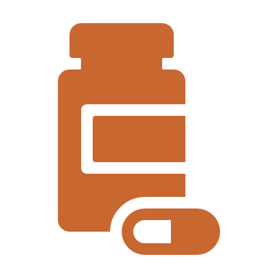




Agenda
Introduction to Policy as Code
Importance of Cloud Security
What is OPA and Conftest?
Terraform + OPA Integration
Demo Walkthrough
Best Practices
Q&A
https://vpnoverview.com/news/sega-europe-security-report/
https://www.vpnmentor.com/blog/report-sennheiser-leak/
https://www.vpnmentor.com/blog/report-ghana-nss-leak/
https://www.comparitech.com/blog/information-security/utah-covid-test-center-leak/

Slide 3


What is Policy as Code (PaC)?
PAC MEANS WRITING SECURITY AND COMPLIANCE RULES IN CODE
ENFORCED AUTOMATICALLY DURING DEVELOPMENT AND DEPLOYMENT

Slide 4
What is Policy as Code (PaC)?
Policy as Code means writing security and compliance rules as code
Enables automated enforcement in CI/CD pipelines
Ensures consistent and auditable compliance checks
Policies define what is allowed or denied in infrastructure and application behavior.

Slide 5
Common Type of PaC
Security
Compliance
Governance
FinOps

Slide 6



Why Use Policy as Code?
Reduces the risk of human error
Enforces consistent rules
Increases speed and safety of deployments

Slide 7
Key Benefit of Using PaC
Proactive Security: Catch violations before deployment.
Compliance Automation: Ensure adherence to standards (SOC2, PCI-DSS, etc.)
Reduced Human Error: Eliminate manual policy checks.
Audit Trail: Complete history of policy decisions.
Automation: Policies run automatically in pipelines
Consistency: policies used among dev, test, and prod, no additional policies needed
Vision Control: Track policies changes over time.
Speed: Rapid policy deployment.
Testable: Policies can be test easily treat as code.

Slide 8
Traditional vs. Policy as Code
Aspect | Traditional Approach | Policy as Code (PaC)
Policy Management | Policies exist in documents or team guidelines | Policies are written as code, version-controlled
Enforcement | Manual checks by security or DevOps teams | Automated validation in CI/CD pipelines
Timing | Late in development or pre-deployment reviews | Early in the Dev cycle (shift-left security)
Error Detection | After resources are deployed | Before resources are deployed
Scalability | Difficult to maintain across teams and projects | Scales easily with code reuse and pipelines
Auditability | Not always tracked or consistent | Changes are tracked via Git, enabling audits
Developer Experience | Slows down deployment due to late feedback | Developers get instant feedback on violations

Slide 9


Importance of Cloud Security
Why Cloud Security Matters
With the widespread adoption of public cloud platforms like Azure, AWS, and GCP, organizations are moving critical workloads—including sensitive data, customer information, and internal systems—to the cloud.
While the cloud offers scalability and flexibility, it also introduces new attack surfaces and risks if not secured properly.

Slide 10
Compliance Challenges in Cloud
Organizations operating in regulated industries—like healthcare, finance, and government—must comply with strict legal and industry standards for data protection, security, and privacy.
Cloud environments introduce new challenges:
Shared responsibility between provider and customer
Fast-changing infrastructure
Difficulty maintaining continuous compliance at scale

Slide 11


How PaC Helps with Compliance
Compliance teams often work separately from developers, leading to delays and missed requirements. Policy as Code (PaC) integrates compliance directly into the development process—shifting compliance left and making it a shared responsibility.
DevSecOps is the practice of integrating security and compliance into DevOps workflows
PaC is a key enabler of DevSecOps because it ensures:
Security policies are not optional
Compliance checks are automated
Feedback is delivered early in the CI/CD pipeline
PaC embeds security and compliance policies into code — just like application logic or infrastructure — and treats them as first-class citizens in the development lifecycle.

Slide 12
Core Tool Used
Terraform: Infrastructure as Code tool for building, changing, and versioning infrastructure
Open Policy Agent (OPA): General-purpose policy engine that provides a unified way to enforce policies across your stack
Conftest: Utility for testing structured configuration data against OPA policies
Github Actions: CI/CD platform for automating policy enforcement in your deployment pipeline
Developer → Git Push → GitHub Actions → Terraform Plan → Conftest/OPA → Policy Validation → Deploy/Reject

Slide 13
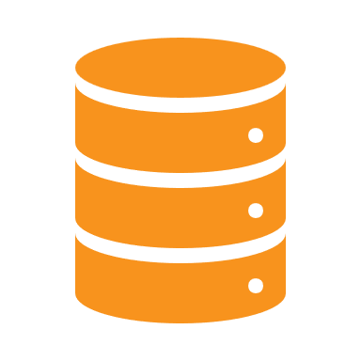
Overview of Open Policy Agent (OPA)
Open-source policy engine
Works with many systems (K8s, Terraform, APIs)

Slide 14
Rego – OPA's Policy Language
Declarative language for defining rules
Simple syntax example for deny rule

Slide 15
What is Conftest?
CLI tool to evaluate config files using OPA
Works with JSON/YAML (Terraform plans, K8s manifests)

Slide 16


Terraform Overview
IaC tool for managing cloud infrastructure
Terraform plan and apply lifecycle

Slide 17

OPA + Terraform Integration
Terraform plan output as JSON
Conftest checks that plan using Rego rules

Slide 18
GitHub Actions in CI/CD
AUTOMATES CHECKS ON PUSH OR PR
INTEGRATES WITH TERRAFORM AND CONFTEST

Slide 19
CI/CD Workflow Diagram
Developer
GitHub PR
CI pipeline
OPA checks

Slide 20
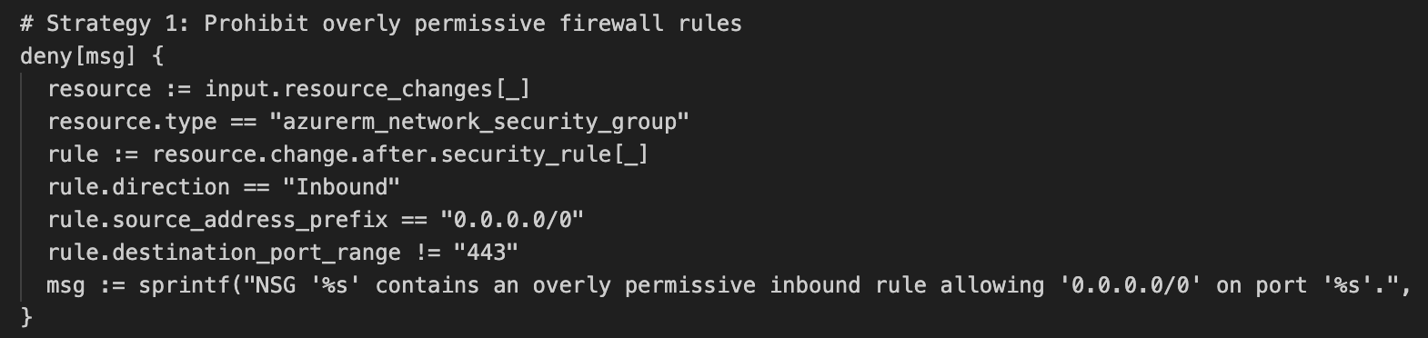
Policy #1 Prohibit overly permissive firewall rules

Slide 21
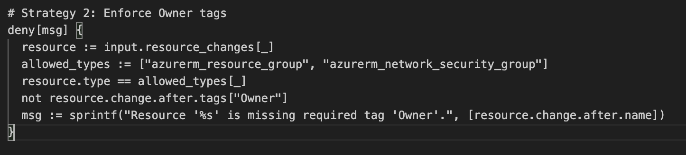
Policy #2 - Enforce Owner tags

Slide 22
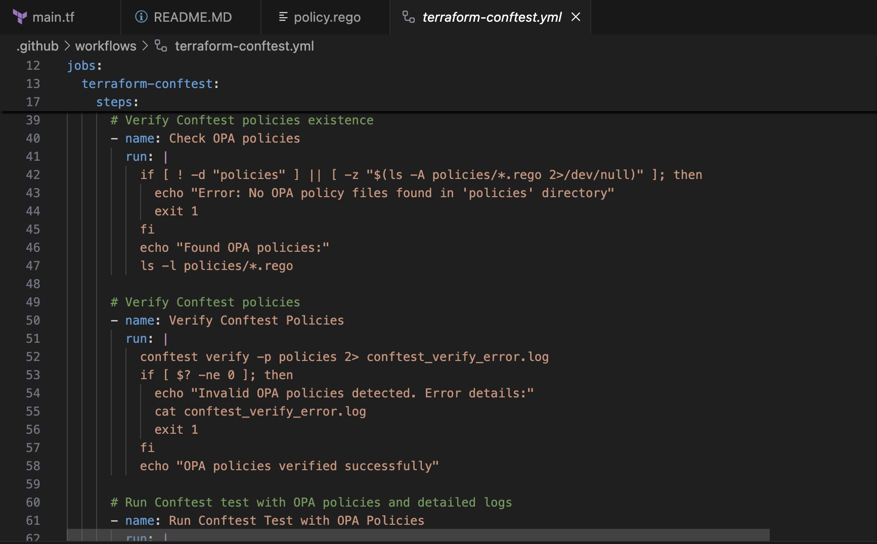
GitHub Actions Integration

Slide 23
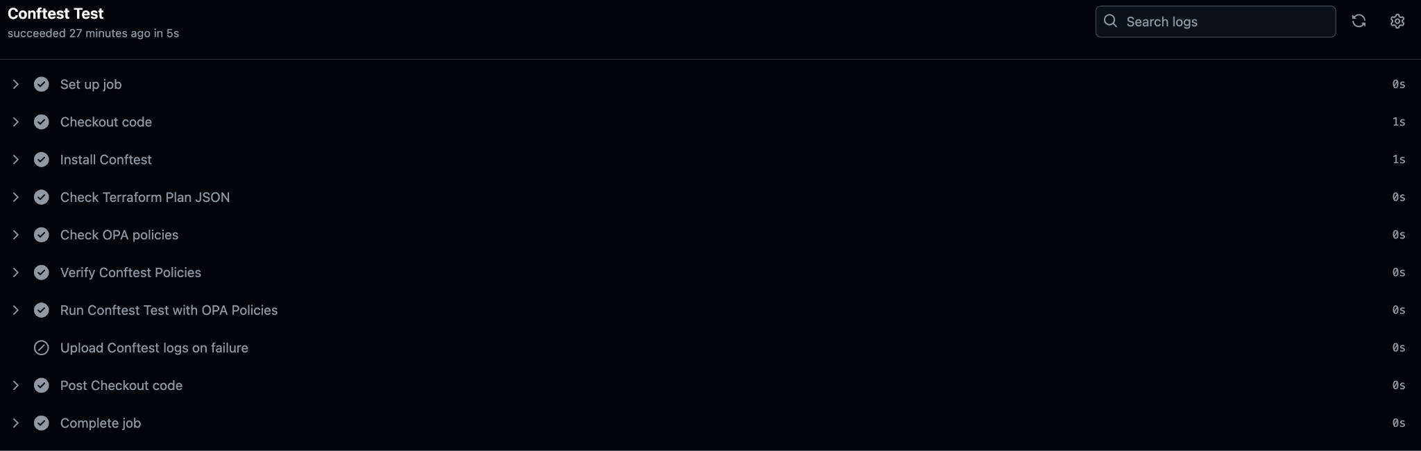
GitHub Actions Integration

Slide 24
Thank You!
Quiz Time.

